Slide 1

ECE 5706: Resilient Computer System Design
Error Detection & Correction in
Memory Subsystems
Xin Xin
Assistant Professor
Electrical and Computer Engineering

Slide 2
Agenda
Memory Resilient Design @ MemArch Lab
Reliability
  Reliability Enhancement
  Reliability -> Performance
  Reliability -> Cost
Cost
Perform.
2

Slide 3
Case Study 1: HBM ECC
HBM-CASO: A Coordinated Approach to
HBM System-Level and On-Die ECC
Ruizhi Zhu, Yanan Guo, Huize Li, Weidong Cao, Qian Lou, and Xin Xin, "HBM-CASO: A Coordinated Approach to HBM System-Level and On-Die ECC." ISCA 2026.

Slide 4
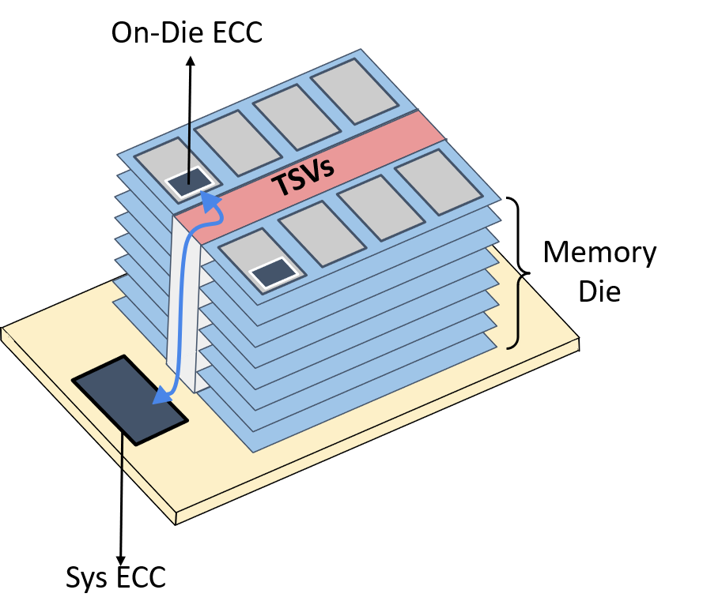
HBM Dual-Layer ECC Architecture
System ECC (SysECC)
• Located in memory controller
• Flexible, but consumes parity bandwidth
ECC Terminology
Error Detection: CRC
Bit-Level Correction: Hamming / SEC
Symbol-Level Correction: Reed–Solomon(RS)
On-Die ECC (ODECC)
• Located inside DRAM memory die
• Efficient, but resource-limited
PHY

Slide 5
HBM Generation Evolution
HBM1
Memory Controller
DRAM Die
Data
Optional ECC
Write
Mem
Array
Read

Slide 6
HBM Generation Evolution
HBM1
Memory Controller
DRAM Die
Data
Optiannl ECC
Write
Mem
Array
HBM2
Read
DRAM Die
Memory Controller
Data + SysECC
Write
Mem
Array
SEC-DED
Read

Slide 7
HBM Generation Evolution
HBM1
Memory Controller
DRAM Die
Data
Optiannl ECC
Write
Mem
Array
HBM2E
Read
Memory Controller
DRAM Die
HBM2
Memory Controller
DRAM Die
Data + SysECC
Data + SysECC
Data + SysECC + ODECC
SEC-DED
Write
Mem
Array
Read
SEC-DED
Write
Mem
Array
SEC-DED
Read

Slide 8
HBM Generation Evolution
HBM1
Memory Controller
DRAM Die
Data
HBM3
Optiannl ECC
Write
Mem
Array
Read
Memory Controller
DRAM Die
HBM2
Memory Controller
DRAM Die
Data + CRC
Data + SysECC
Data + ODECC
SEC-DED
Write
Mem
Array
Small RS
Mem
Array
CRC
Write
Read
CRC
HBM2E
Read
Memory Controller
DRAM Die
Data + SysECC
Data + SysECC + ODECC
SEC-DED
Write
Mem
Array
SEC-DED
Read

Slide 9

HBM Generation Evolution
HBM1
Memory Controller
DRAM Die
Data
Optiannl ECC
Write
Mem
Array
Read
What if processors are willing to provide stronger ECC?
HBM2
Memory Controller
DRAM Die
Data + SysECC
SEC-DED
Write
Mem
Array
ECC responsibility gradually shifts from the memory controller to the DRAM die
Read
Memory Controller
HBM2E
DRAM Die
Data + SysECC
Data + SysECC + ODECC
SEC-DED
Write
Mem
Array
SEC-DED
Read
Memory Controller
HBM3
DRAM Die
Data + CRC
Data + ODECC
Small RS
Mem
Array
CRC
Write
CRC
Read

Slide 10
HBM Generation Evolution
New mode for HBM3
Memory Controller
DRAM Die
Data + SysECC (64B + 4B)
Data + SysECC + ODECC
Advanced
RS
Write
Merge RS
Mem
Array
CRC
Read

Slide 11



Three Challenges for Supporting SysECC
1.Parity Storage
HBM3
Our Scheme
Data + Parity(8B → ODECC)
Data + Parity(8B → SysECC+ODECC)
2.Write Verify
Data + CRC
Data + SysECC
Write
Write
3. Read Decode
Small RS
Data + ODECC
Merge RS
Data + SysECC + ODECC

Slide 12



HBM-CASO: Three Key Techniques
1
2
3
Codeword Merge
Delayed Write
Verification
Decoupled Read
Protection

Slide 13
Technique 1: Codeword Merge
Pseudo Channel
RS-Parity
SSC- Singe Symbol Correction

Slide 14
Technique 1: Codeword Merge
+
Pseudo Channel
RS-Parity
SSC- Singe Symbol Correction

Slide 15
Technique 1: Codeword Merge
Pseudo Channel
RS-Parity
SSC- Singe Symbol Correction

Slide 16
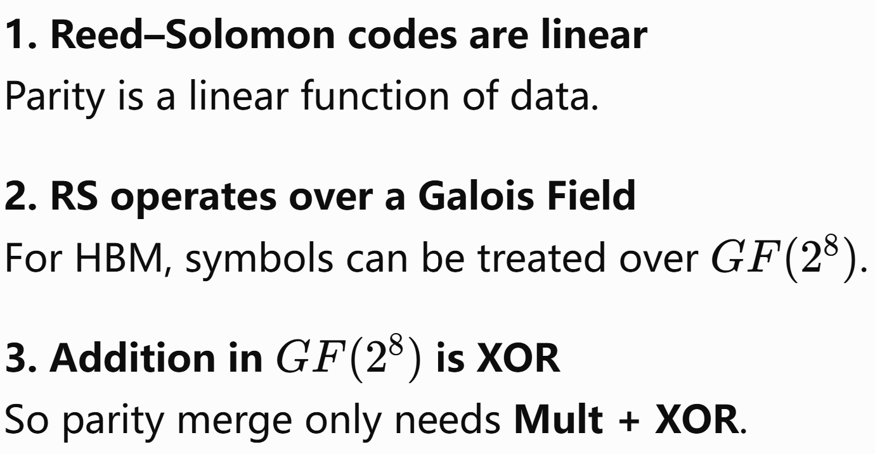
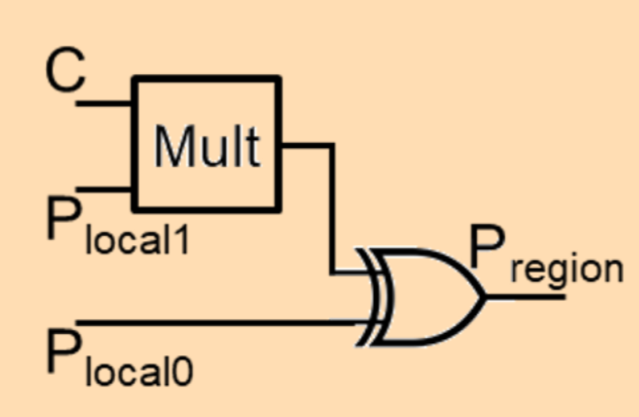

Technique 1: Codeword Merge
Pseudo Channel
Added Logic
SSC

Slide 17
Technique 2: Delayed Write Verification
Baseline
Memory Controller
Verify
DRAM Die
Data
Data + CRC
CRC
CRC
Small
RS
Write transfer
System level side
On-die level side

Slide 18
Technique 2: Delayed Write Verification
Our Scheme
Memory Controller
DRAM Die
Data
Data + SysECC
Advanced
RS
Small
RS
CRC
Write transfer
generate parity
generate parity
Buffer
Buffer
System level side
On-die level side
Until: Accumulate parity across the entire write batch

Slide 19
Technique 2: Delayed Write Verification
Our Scheme
Memory Controller
DRAM Die
Accumulated Parity (64bit)
Advanced
RS
Small
RS
CRC
An extra Write transfer
Verify
Buffer
Buffer
If Mismatch
→ Retry the Whole Batch
If Match → Success
System level side
On-die level side

Slide 20
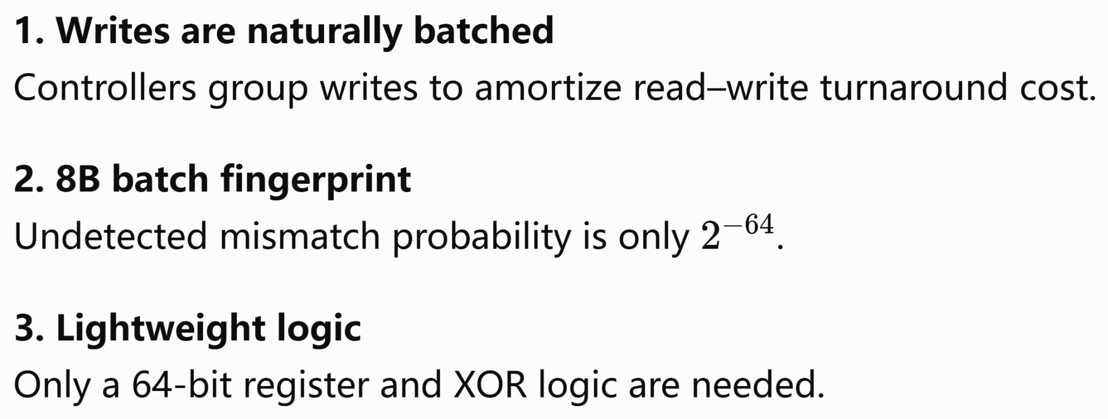
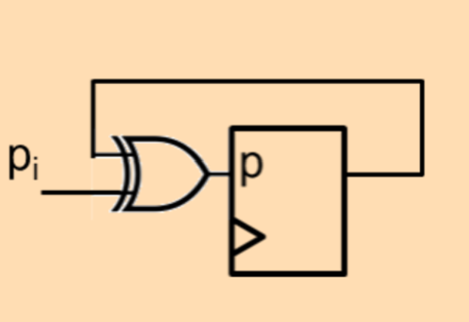
Technique 2: Delayed Write Verification
Pseudo Channel
Added Logic
SSC

Slide 21
Technique 3: Decoupled Read Protection
1. Move complex decoding to MC
Avoid costly on-die RS correction.
2. Correction is rare
Most reads only need detection.
3. Preserve HBM scrubbing
HBM-CASO remains compatible with periodic error scrubbing.
Correct when needed
Detect only
Advanced
RS
Merge
RS
CRC
Buffer
Buffer
System level side
On-die level side

Slide 22


Correction Capability
Baseline
R-mode
G-mode
Symbol Error

Slide 23
Results
Reliability: Error Coverage Comparison
Selected Fault Scenarios (DCE%)
Error Type
Base(8b)
Base(16b)
R-mode
G-mode
DUO
Config
COMET
1 SBF
100
100
100
100
100
100
100
2 SBF
76.6
56.3
100
100
100
1.6
100
1SBF+1WBF
51.6
54.8
51.6
100
100
0.0
0.03
2 WBF
0.0
50.0
50.0
100
100
0.0
0.0
3 SBF
41.0
9.7
77.3
100
100
0.02
100
4 SBF
13.0
1.4
42.2
99.0
100
0.0
27.7
4 BBF
13.1
1.4
42.2
99.0
100
0.0
0.0
1 SAF
0.0
0.0
0.0
0.0
0.0
0.0
0.0
HBM-CASO provides much stronger error coverage than HBM baselines, with G-mode close to DUO

Slide 24
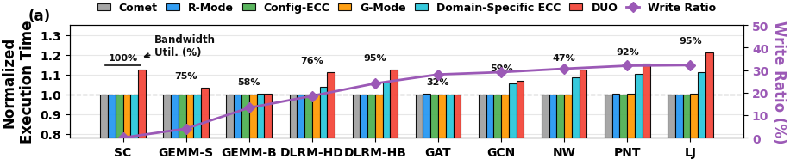
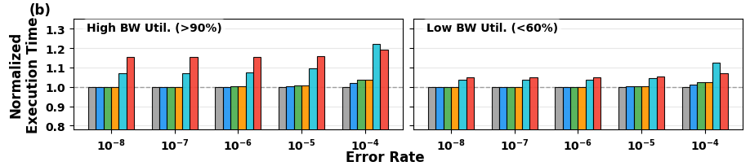
Results
Performance Analysis
1. Near-baseline in normal cases
2. Much lower overhead than DUO

Slide 25
Case Study 2: ECC -> Performance
ASPA: Reassigning DDR5 Parity Bandwidth
Fan Li, Qiufeng Li, Yanan Guo, Weidong Cao, and Xin Xin, "ASPA: Reassigning DDR5 Parity Bandwidth." HPCA 2026.

Slide 26




DDR5 Memory Systems
DIMMs
DRAMs
Data
Mem Channels
@ Cluster
Data Bandwidth
Server
ECC Parity

Slide 27
DDR5 Memory Systems
DIMMs
DRAMs
Data
Memory Wall
Mem Channels
@ Cluster
Data Bandwidth
Server
ECC Parity

Slide 28
DDR5 Memory Systems
DIMMs
DRAMs
Data
Popular solutions
(bandwidth extension & high cost)
-New DDR generations(DDR6)
-New memory architecture(HBM)
-New memory paradigm(PIM,NDP)
…
Mem Channels
@ Cluster
Bandwidth
ECC Parity

Slide 29
DDR5 Memory Systems
DIMMs
DRAMs
Data
Mem Channels
@ Cluster
80% data
Data Bandwidth
Chip Bandwidth
20% parity
Parity
ECC Chips
ECC Parity

Slide 30
Design Overview
Cacheline
Baseline
Cacheline
ASPA
offset
offset
0x0000
0x0000
0x0040
0x0050
0x0080
0x00a0
0x00C0
0x00f0
0x0100
0x0140
0x0140
0x0190
0x0180
0x01E0
0x01C0
0x0230
… …
Data
32-bit
Parity
8-bit
Data
40-bit
Tier-2 Parity
Regular access
Non-trod granularity

Slide 31
Design Overview
Sequential
Access
Cacheline
Baseline
Cacheline
ASPA
offset
offset
0x0000
0x0000
0x0040
0x0050
0x0080
0x00a0
0x00C0
0x00f0
0x0100
0x0140
0x0140
0x0190
0x0180
0x01E0
0x01C0
0x0230
… …
Data
32-bit
Parity
8-bit
Data
40-bit
Tier-2 Parity
Regular access
Non-trod granularity

Slide 32
Design Overview
Sequential
Access
Cacheline
Baseline
Cacheline
ASPA
offset
offset
0x0000
0x0000
0x0040
0x0050
0x0080
0x00a0
0x00C0
0x00f0
0x0100
0x0140
0x0140
0x0190
0x0180
0x01E0
0x01C0
0x0230
… …
Data
32-bit
Parity
8-bit
Data
40-bit
Tier-2 Parity
Regular access
Non-trod granularity

Slide 33
Design Overview
Cacheline
Baseline
Cacheline
ASPA
offset
offset
0x0000
0x0000
0x0040
0x0050
Challenge I: designing a new logic to effectively reassign the available bandwidth
0x0080
0x00a0
0x00C0
0x00f0
0x0100
0x0140
0x0140
0x0190
0x0180
0x01E0
0x01C0
0x0230
… …
Data
32-bit
Parity
8-bit
Data
40-bit
Tier-2 Parity
Regular access
Non-trod granularity

Slide 34
Design Overview
Cacheline
Baseline
ASPA
offset
offset
0x0000
0x0000
Cacheline
0x0040
0x0050
Challenge I: designing a new logic to effectively reassign the available bandwidth
0x0080
0x00a0
0x00C0
0x00f0
0x0100
0x0140
0x0140
0x0190
0x0180
0x01E0
Challenge II: achieving enhanced ECC capabilities while maintaining the original ECC detection strength.
0x01C0
0x0220
… …
Data
32-bit
Parity
8-bit
Data
40-bit
Tier-2 Parity
Regular access
Non-trod granularity

Slide 35
x4
x4
DRAM I/O Configurations
x32 subchannel
x4
x4
x4
x4
x4
x4
x4
x4
x8
x8
x8
x8
x32 subchannel
x16
x16
x32 subchannel

Slide 36
x4
x4
DRAM I/O Configurations
Typical server choice
x4
x4
x4
x4
x4
x4
x4
x4
x8
x8
x8
x8
x32 subchannel
x16
x16
x32 subchannel

Slide 37
Bandwidth Distribution
x4
x4
x4
x4
x4
x4
x4
x4
x4
x4
Memory subchannel
4b*BL*8chips=64B data
(Cacheline)
4b*BL*2chips=16B parity
(ECC codeword)
BL(Burst Length)=16

Slide 38
Bandwidth Distribution
x4
x4
x4
x4
x4
x4
x4
x4
x4
x4
?
Memory subchannel
?
4b*BL*8chips=64B data
(Cacheline)
4b*BL*2chips=16B data
(1/4 Cacheline)
BL(Burst Length)=16
Notes:
While these ecc chip’s bandwidth is built in from DIMM, it provides no help to the system bandwidth, representing an obvious waste. If we could use the I/O of the ECC chips to transmit regular data, it would seem to be a very interesting solution.

Slide 39
x4
x4
Common Die
x4
x4
x4
x4
x4
x4
x4
x4
x8
x8
x8
x8
x16
x16
Common die
Same operation logic
Notes:
Recalling the different DRAM data widths we saw earlier, manufacturers tend to use identical die for x4, x8, and even x16 to simplify the pipeline. which means They share exactly the same internal bandwidth and IO logic.

Slide 40
Challenge I: Reassign Bandwidth
x4 DRAM Chip
x8 DRAM Chip
Banks
Banks
IO buffer
IO buffer
CRC Unit
CRC Unit
serializer
serializer
Pin [0-3]
Pin [4-7](disabled)
Pin [4-7](enabled)
Pin [0-3]

Slide 41
Challenge I: Reassign Bandwidth
x4 DRAM Chip
x5 DRAM Chip
Banks
Banks
IO buffer
IO buffer
CRC Unit
CRC Unit
serializer
serializer
Pin [0-3]
Pin [4-7](disabled)
Pin [4](enabled)
Pin [0-3]

Slide 42
Challenge I: Reassign Bandwidth
x4
x4
x4
x4
x4
x4
x4
x4
x4
x4
Mem. Channel
4b*BL*8chips=64B data
(Cacheline)
4b*BL*2chips=128b parity
BL(Burst Length)=16

Slide 43
Challenge I: Reassign Bandwidth
Baseline
16 transfers = 1 Cacheline
ASPA
- 26 transfers = 2 Cachelines
x5
x5
x5
x5
x4
x5
x5
x5
x5
x4
Mem. Channel
5b*BL*8chips=130B data
(2 Cachelines)
4b*BL*2chips=128b parity
BL(Burst Length)=26

Slide 44
ASPA -- Fixed Buffering
x5 DRAM Chip
BL=26
❶
128b IO Buffer
+128b
Banks
-130b
❷
128b
IO buffer
CRC8
32
x5
x5
x5
x5
CRC8
x4
CRC8
5BL=130b
serializer
CRC8
x5
x5
x5
x5
x4
Pin [0-3]
Pin [4](enabled)

Slide 45
ASPA -- Fixed Buffering
x5 DRAM Chip
BL=26
❶
128b IO Buffer
+128b
Banks
-130b
❷
128b
2B bubbles per burst
IO buffer
32
CRC8
x5
x5
x5
x5
CRC8
x4
CRC8
5BL=130b
serializer
CRC8
x5
x5
x5
x5
x4
Pin [0-3]
Pin [4](enabled)

Slide 46
ASPA -- Adaptive Buffering
x5 DRAM Chip
BL=16
Banks
IO buffer
CRC Unit
serializer
Pin [4](enabled)
Pin [0-3]

Slide 47
ASPA -- Adaptive Buffering
x5 DRAM Chip
BL=16
Banks
IO buffer
CRC Unit
serializer
5BL=80bits
Pin [4](enabled)
Pin [0-3]

Slide 48
ASPA -- Adaptive Buffering
x5 DRAM Chip
BL=16
❶
128b IO Buffer
+128b
Banks
IO buffer
CRC Unit
serializer
5BL=80bits
Pin [4](enabled)

Slide 49
ASPA -- Adaptive Buffering
x5 DRAM Chip
BL=16
❶
128b IO Buffer
+128b
Banks
-80b
❷
64b
IO buffer
+64b
48b
CRC Unit
serializer
5BL=80bits
Pin [4](enabled)

Slide 50
ASPA -- Adaptive Buffering
x5 DRAM Chip
BL=16
❶
128b IO Buffer
+128b
Banks
-80b
❷
64b
IO buffer
+64b
-80b
48b
CRC Unit
❸
serializer
+64b
32b
5BL=80bits
Pin [4](enabled)

Slide 51
ASPA -- Adaptive Buffering
x5 DRAM Chip
BL=16
❶
128b IO Buffer
+128b
Banks
-80b
❷
64b
IO buffer
+64b
-80b
48b
CRC Unit
❸
serializer
+64b
-80b
32b
5BL=80bits
❹
+64b
16b
Pin [4](enabled)
-80b

Slide 52










Challenge II: Reliability
Detection
Correction
$$Σ$$
$$O\left(1\right)$$
$$O\left(√n\right)$$
$$Σ$$
$$Σ$$
$$Σ$$
$$Σ$$
$$Σ$$
$$Σ$$
$$Σ$$
Larger Codeword, Cheaper Detection

Slide 53


Challenge II: Reliability
Detection
Correction
$$Σ$$
Detection is much more light-weight than correction
$$O\left(1\right)$$
$$O\left(√n\right)$$
$$Σ$$
$$Σ$$
$$Σ$$
$$Σ$$
$$Σ$$
$$Σ$$
$$Σ$$
Larger Codeword, Cheaper Detection

Slide 54

Detection Capability
512b Cacheline
32b Parity
Collision rate: $2^{−32}$, sufficient for error detection

Slide 55
Detection Capability
512b Cacheline
64b Parity
Collision rate: $2^{−64}$, exponential sufficient for error detection
512b Cacheline
512b Cacheline
…
512b Cacheline
64b Parity
Collision rate: $2^{−64}$, exponential sufficient for error detection

Slide 56
Detection Capability
Common die
ECC chip
Bank
Bank
IO buffer
IO buffer
CRC8
CRC8
CRC8
CRC8
CRC8
CRC8
serializer
CRC8
serializer
CRC8
1
IO drivers
IO drivers
Pin disabled

Slide 57
Detection Capability
512b Cacheline
128b Parity
Collusion probability= $2^{−128}$>> 512 single bit flip cases
512b Cacheline
128b Parity
512b Cacheline
128b Parity
CRC Unit
64b
…
512b Cacheline
128b Parity
Collusion probability= $2^{−64}$>> 512*16 single bit flip cases

Slide 58
Error Detection & Correction Logic
ECC chip
Read
Bulk-sized Data w/ Tier-2 Parity
Parity
Check
Pass
No Error
Bank
Fail
IO buffer
Reread
Bulk-sized Data
w/ Tier-1 Parity
CRC8
CRC8
CRC8
Error
Correct
serializer
CRC8
Detected but Uncorrected
Fail
Pass
Corrected
1
IO drivers
Pin disabled

Slide 59
Workflow
0x0000
0x0040
0x0080
0x00C0
0x0100
CRC
Cacheline Offset
0x0140
0x0180
0x01C0
0x0200
0x0240
Tier-2 ECC
… …
Data Bandwidth
32-bit
Parity Bdw
8-bit

Slide 60
Workflow
0x0000
0x0040
0x0080
0x00C0
0x0100
CRC
Cacheline Offset
0x0140
0x0180
0x01C0
0x0200
0x0240
Tier-2 ECC
… …
Data Bandwidth
32-bit
Parity Bdw
8-bit

Slide 61
Workflow
0x0000
0x0040
0x0080
0x00C0
0x0100
CRC
Cacheline Offset
0x0140
0x0180
0x01C0
0x0200
0x0240
Tier-2 ECC
… …
Data Bandwidth
32-bit
Parity Bdw
8-bit

Slide 62
Workflow
0x0000
0x0040
0x0080
0x00C0
0x0100
CRC
Cacheline Offset
0x0140
0x0180
0x01C0
0x0200
0x0240
Tier-2 ECC
… …
Data Bandwidth
32-bit
Parity Bdw
8-bit

Slide 63
Workflow
0x0000
0x0040
0x0080
0x00C0
0x0100
CRC
Cacheline Offset
0x0140
0x0180
0x01C0
0x0200
0x0240
Tier-2 ECC
… …
Data Bandwidth
32-bit
Parity Bdw
8-bit
Tier-2 ECC

Slide 64
Workflow
0x0000
0x0040
0x0080
0x00C0
0x0100
Tier-2 ECC
Cacheline Offset
0x0140
0x0180
0x01C0
0x0200
0x0240
Tier-2 ECC
… …
Data Bandwidth
32-bit
Parity Bdw
8-bit
96% DRAM bandwidth utilized for data transfer

Slide 65
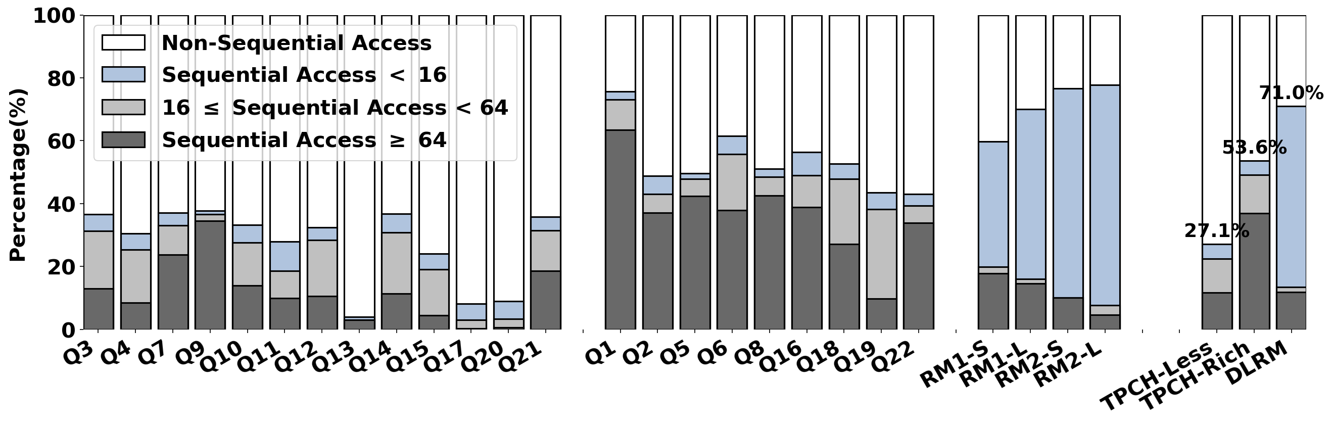
Access Pattern of Workloads
large-scale sequential accesses
small-scale sequential accesses

Slide 66
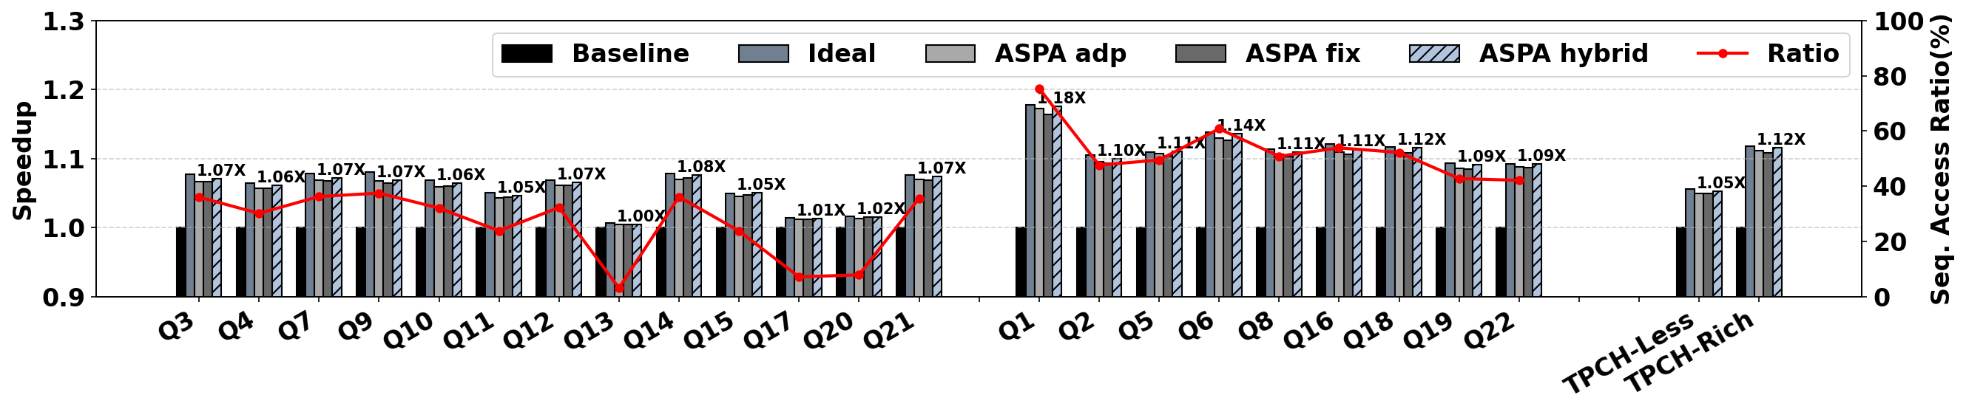
Performance

Slide 67
Case Study 3: ECC -> Cost
SCREME: A Scalable Framework for Resilient Memory Design
Fan Li, Mimi Xie, Yanan Guo, Huize Li, and Xin Xin, "SCREME: A Scalable Framework for Resilient Memory Design." PACT 2025.

Slide 68
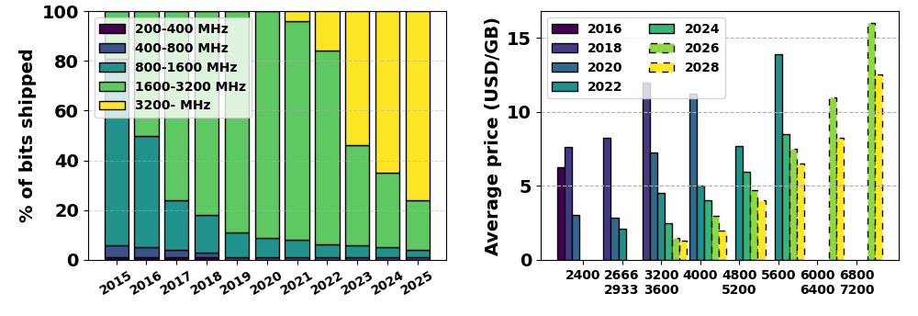
Motivation
Legacy DRAM chips are slow but low-cost.

Slide 69
Motivation
Server
ECC Chips
Servers require costly ECC chips to ensure data-integrity.

Slide 70
Motivation
Leverage surplus(slow) chips can amortize ECC cost.
Server
ECC Chips

Slide 71
SCREME-Framework
Objective: Enable scalable and cost-efficient memory fault tolerance framework.
Foundation 1
Detection is more light-weight
SCREME-WO
SCREME-Framework
Foundation 2
Chips share the common die
SCREME-I/O

Slide 72
Design1: SCREME-WO(Write-Only ECC)
READ 0x0000FFFF
No Error
Baseline
Pass
Corrected
Correct
Data & Two Symbols
Detected
Fail

Slide 73
Design1: SCREME-WO(Write-Only ECC)
READ 0x0000FFFF
Fetch the Remaining
Symbol
SCREME-WO
Detect
Correct
Data & One Symbol
Fail
99.9999% Cases
Pass
Fail
Pass
No Error
Detected
Corrected

Slide 74
Design1: SCREME-WO(Write-Only ECC)
READ 0x0000FFFF
Fetch the Remaining
Symbol
Legacy chips are slow but low-cost
READ: Half ECC bandwidth(fetch one symbol)
SCREME-WO
Detect
Correct
Data & One Symbol
Fail
WRITE: Full ECC bandwidth(update all ECC symbols)
Pass
Fail
Pass
Repurpose ECC bandwidth:
From READ to low-cost chip’s SLOW WRITE
No Error
Detected
Corrected

Slide 75
Design1: SCREME-WO(Write-Only ECC)
Data Chips
ECC Chips
Employ a slow chip as a write-only ECC chip.
…
WRITE-ONLY
$
6400MT/s
× 4 (× 9 chips)
3200MT/s
× 4
WRITE-ONLY
Employ various slow chips to store parity data with buffer support.
$
$
4800MT/s
× 2
and
3200MT/s
× 6
…
6400MT/s
× 4 (× 9 chips)
6400MT/s × 4

Slide 76

Design1: SCREME-WO(Write-Only ECC)
Bubble condition: $t_{1}’− t_{1}>t_{2}$
Parity Data Buffer
Read Buffer
Write Buffer
Slow Writes
0
t₁'
Regular Writes
Regular Reads
Regular Writes
0
t₁
t₂
Bubble

Slide 77
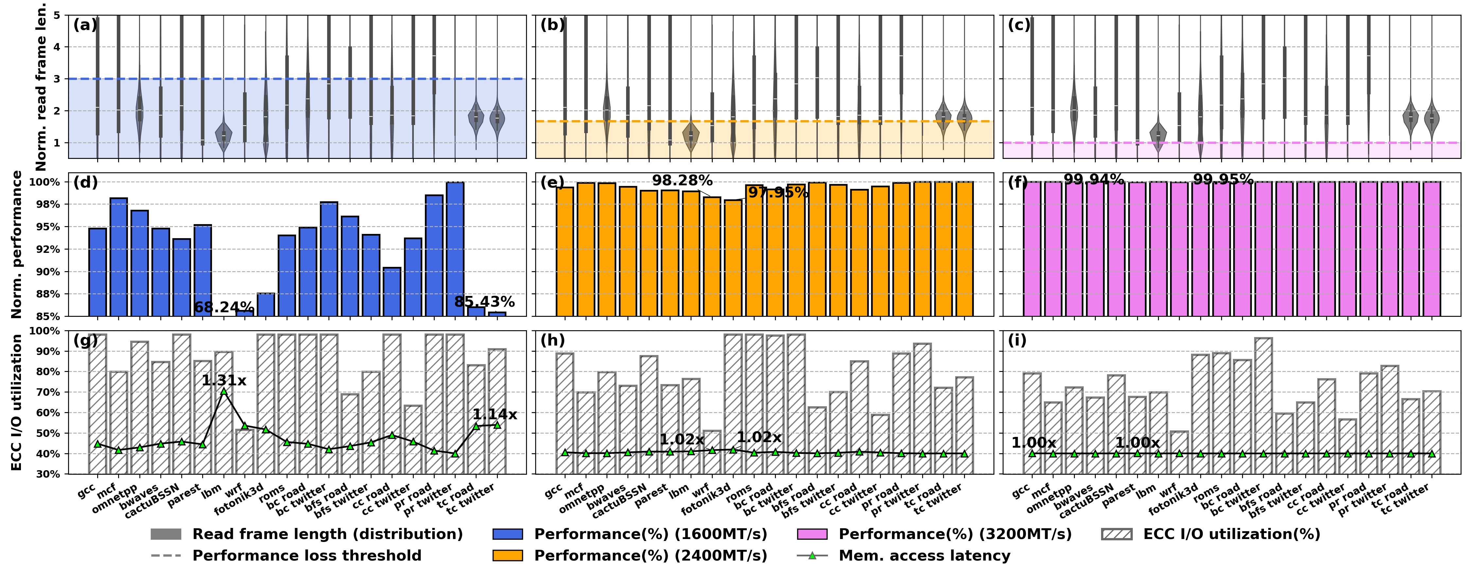

Design1: SCREME-WO(Write-Only ECC)
Regular: 6400MHz & Slow:1600MHz
Distribution of $t_{1}’−t_{1}$
$$t_{1}’−t_{1}$$

Slide 78
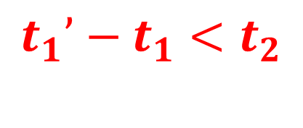

Design1: SCREME-WO(Write-Only ECC)
Regular: 6400MHz & Slow:1600MHz
$$t_{2}$$
$$t_{1}’−t_{1}$$
$$t_{1}’−t_{1}<t_{2}$$

Slide 79
Design1: SCREME-WO(Write-Only ECC)
Regular: 6400MHz & Slow:1600MHz
$$\text{Performance}$$

Slide 80

Design1: SCREME-WO(Write-Only ECC)
Regular: 6400MHz & Slow:2400MHz
$$t_{1}’−t_{1}$$
$$t_{2}$$

Slide 81
Design1: SCREME-WO(Write-Only ECC)
Regular: 6400MHz & Slow:2400MHz
$$\text{Performance}$$

Slide 82

Design1: SCREME-WO(Write-Only ECC)
Regular: 6400MHz & Slow:3200MHz
$$t_{1}’−t_{1}$$
$$t_{2}$$

Slide 83

Design1: SCREME-WO(Write-Only ECC)
Regular: 6400MHz & Slow:3200MHz
$$\text{Performance}$$
$$t_{2}$$

Slide 84
Design2: SCREME-I/O
Control Wire Fault(Row Fault)
Data
Data
Bit
Err
Data Wire Fault(Col Fault)
Symbol Err
Chip Err

Slide 85
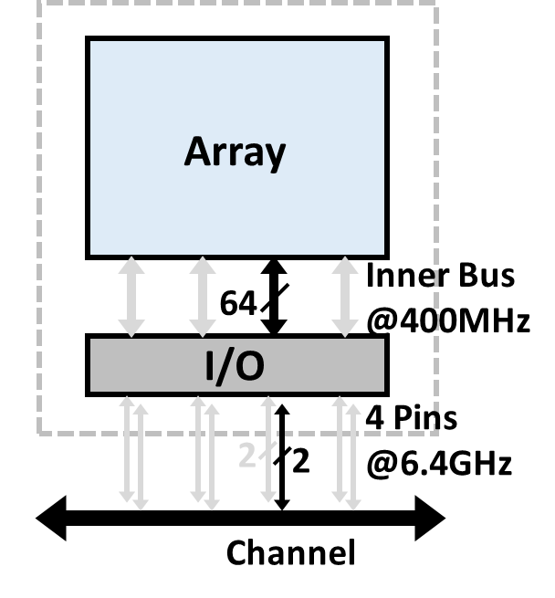
Design2: SCREME-I/O
x8
x4
Enable on demand

Slide 86
Design2: SCREME-I/O
x8
x4
x2
Disable on demand

Slide 87
Design2: SCREME-I/O-Col
Role exchange
x4
ECC
Data
Data
ECC
Rank 0
x2
RCD
Rank 1
Data Wire Fault(Col Fault)
x2
Data Wires
each line is 2-bit
Failed

Slide 88
Design2: SCREME-I/O-Row
Control Wire Fault(Row Fault)
Failed
Rank 0
x4
RCD
Rank 1

Slide 89
Design2: SCREME-I/O-Row
Control Wire Fault(Row Fault)
Failed
Disabled for baseline
Rank 0
x4
RCD
Rank 1

Slide 90
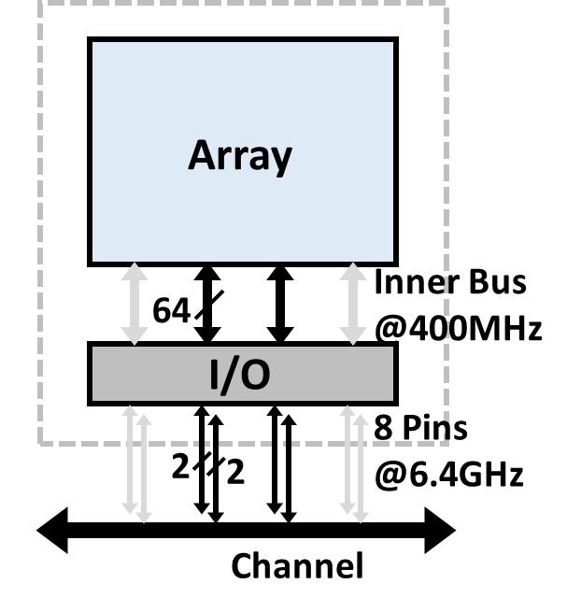
Design2: SCREME-I/O-Row
Failed
Rank 0
x8
x8
x8
x8
x8
RCD
Rank 1
Enable

Slide 91
Design2: SCREME-I/O-Row
Failed
…
A_0
Rank 0
Rank 0
B_0
…
A
RCD
…
Rank 1
A_1
C_0
…
B
Rank 1
…
B_1
Rank 2
C
…
C_1
Enable

Slide 92
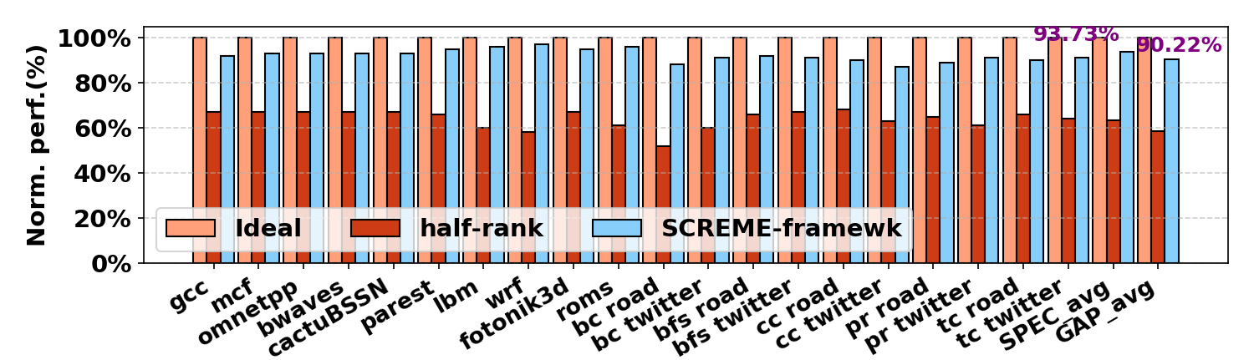
Design2: SCREME-I/O
1.3x Speedup

Slide 93

Design3: SCREME-Framework
Failed
Data
ECC
$
$
$
$
DISABLED
Spare chips
$
$
$
$
RCD

Slide 94
Design3: SCREME-Framework
Role exchange
Data
$
$
$
$
ECC
DISABLED
Spare chips
$
$
$
$
RCD

Slide 95
Design3: SCREME-Framework
More advanced ECC
Data
ECC
$
$
$
$
$
$
$
$
RCD

Slide 96
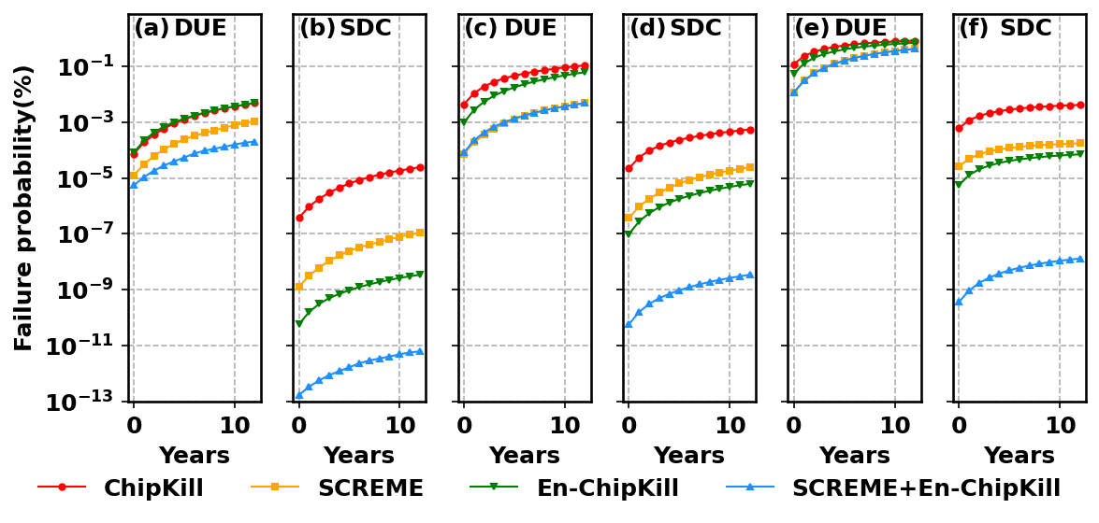
Design3: SCREME-Framework
Regular
One failed chip
135x better
Maintain acceptable reliability

Slide 97
THANK YOU!
Xin Xin
xin.xin@ucf.edu

Slide 98
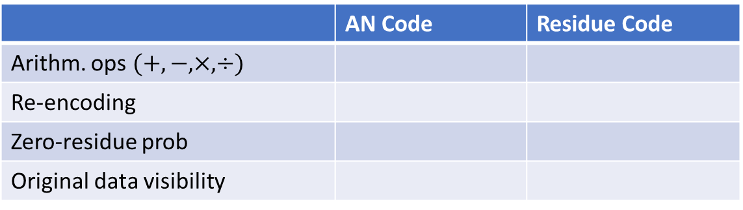
Hw2
AN Code vs Residue Code
Zero prob of Residue Code
A mod Q * B mod Q = (A*B) mod Q
If A mod Q = 0, then errors in B are undetectable.
Solution: if A mod Q = 0, define A’=A+1, Result=A’*B-B
A mod Q * B mod Q * C mod Q * D mod Q = (A*B*C*D) mod Q
If A mod Q = 0 and C mod Q = 0, define A’=A+1, C’=C+1
res0’=A’*B-B+1 ---> res1’=res0’*C’= res0’*C’-res0-C+1 ---> Result=res1’*D= res1’*D-res1
Solution: calculate A*C and B*D separately, define (A*C)’=A*C+1, Result=(A*C)’*B*D-B*D
 | AN Code | Residue Code
Arithm. ops$(+,−, ×, ÷)$
Re-encoding
Zero-residue prob
Original data visibility
98

